Slide 1


Presidency
Presidency
School of Artificial Intelligence and Advanced Computing

Slide 2
Unified Security Scanner + RAG Assistant
CSS7102- Mini Project Review-3
Batch Number : CCS_13
Under the Supervision of,
Dr. Sampath A K
Head of the department (cyber security)
School of Computer Science and Engineering
Presidency University
Roll Number | Student Name
20231CCS0117 20231CCS0125 20231CCS0116 20231CCS0173 | Roopashree M Mohammed Rayyan Khan Shreya Syeda Zaiba
Name of the Program: CCS-Computer Science & Engineering (Cyber Security)
Name of the HoD: Dr. Sampath A K
Name of the Program Project Coordinator: Dr . Sampath A K
Name of the School Project Coordinators: Dr. Sampath A K

Slide 3
Content
➢ Problem Statement
➢ Drawbacks and Proposed System
➢ System Architecture
➢ Modules
➢ Technology Stack
➢ Algorithm / Workflow
➢ Source Code Structure
➢ Implementation Functionality
➢ Results and Discussion
➢ Conclusion
➢ References

Slide 4
Problem Statement
Analysts juggle many scanners; build a unified GUI + RAG assistant across Nmap/OpenVAS/Nessus/Nuclei.
Security analysts often work with multiple security scanners independently, making vulnerability assessment difficult to manage and analyze.
Challenges
Multiple scanner interfaces
Different output formats
Manual vulnerability analysis
Difficulty maintaining scan history
Time-consuming report generation
Lack of centralized security information

Slide 5
Drawbacks and Proposed Methods
Drawbacks
Separate installation
Different command syntax
Different report formats
Manual analysis
No centralized interface
Proposed Methods
Develop a web-based Unified Security Scanner.
Provide a single interface for multiple security scanners.
Accept user input (scanner selection and target).
Execute the selected scanner through the FastAPI backend.
Parse scanner outputs into a common format.

Slide 6
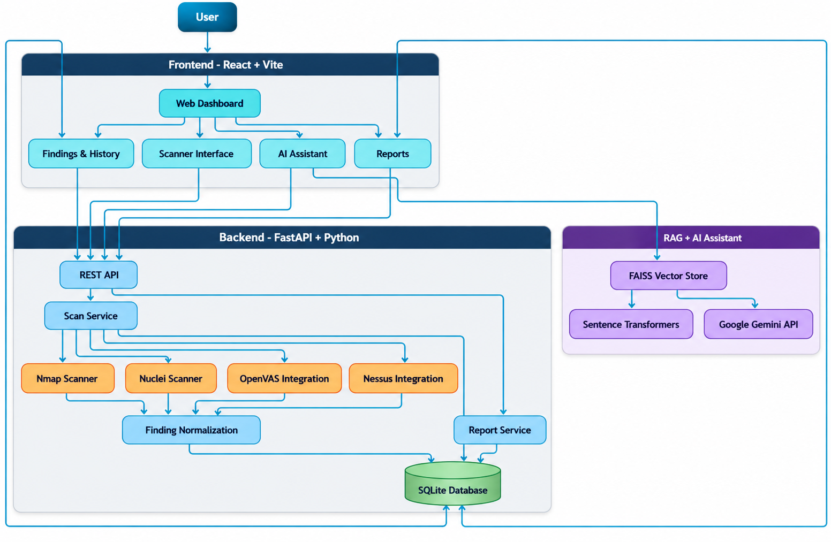
System Architecture

Slide 7
Modules
Module 1 - Frontend
User Interface
Scanner Selection
Target Input
Module 2 -Backend
REST API
Request Validation

Slide 8
Modules
Module 3 - Scanner Integration
Nmap
Nuclei
Nessus
OpenVAS
Module 4 - Output Processing
Parse scanner output
Standardize findings
Display vulnerabilities and Severity
Description

Slide 9
Technology Stack
LAYER | TECHNOLOGY
Frontend | React.js
Backend | Python + FastAPI
Database | SQLite
Network Scanner | Nmap , Nessus
Vulnerability Scanner | Nuclei, OpenVAS
AI | Google Gemini
RAG | LangChain
Embeddings | Sentence Transformers
API Communication | REST API
Development | VS Code / Windows

Slide 10
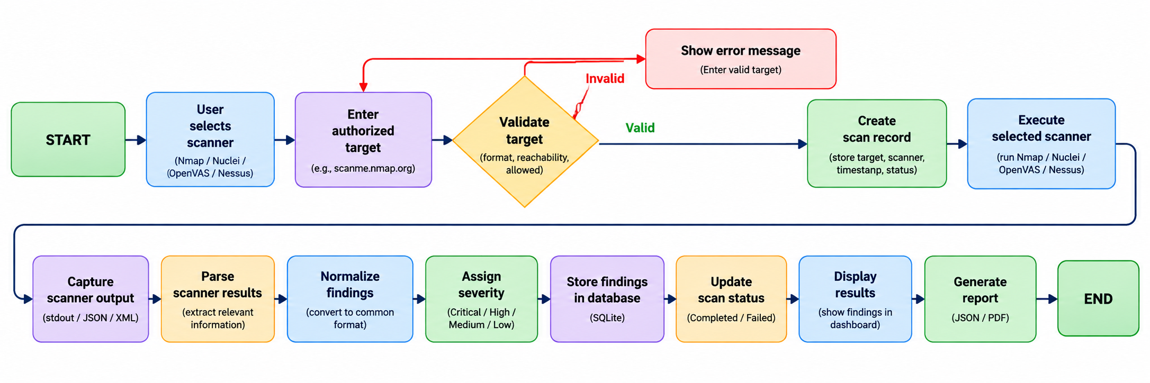
Algorithm 1: Unified Scan Workflow

Slide 11
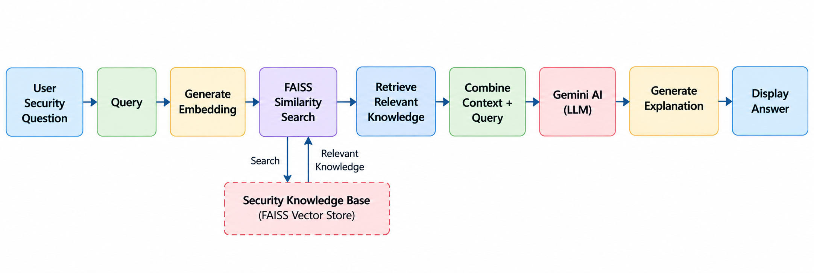
Algorithm 2: RAG + AI Assistant

Slide 12
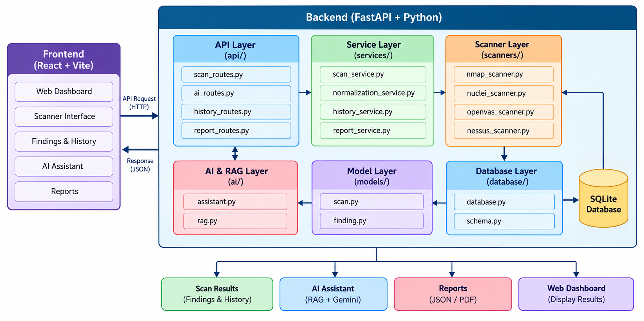
Source Code Structure

Slide 13
Implementation Functionality
Frontend
Security dashboard
Scanner selection
Scan interface
Findings dashboard
AI Assistant
Backend
FastAPI REST API
Scan management
Finding normalization
RAG knowledge retrieval
Security Tools
Nmap — Working
Nuclei — Working
OpenVAS — Integration Pending
Nessus — Integration Pending

Slide 14
Results
The implemented system successfully provides:
Centralized security scanning interface
Real Nmap scan execution
Nuclei scanner integration
Standardized vulnerability findings
Severity-based finding display
RAG-based security knowledge retrieval
Gemini-powered AI assistance
Current Status
Frontend: Implemented
Backend: Implemented
Nmap: Working
Nuclei: Integrated
RAG + Gemini: Implemented

Slide 15
Conclusion
The Unified Security Scanner + RAG Assistant provides a centralized platform for security assessment and vulnerability analysis.
Key Contributions
Unified Scanning
Nmap + Nuclei
Centralized Management
Scans + Findings
Intelligent Assistance
RAG + Gemini
Automated Reporting
JSON format
Extensible Architecture
Ready for additional security scanners

Slide 16
References
1. Automation of Nmap Scanning of Information Systems
https://ieeexplore.ieee.org/document/10496014
2. Web-based Reconnaissance and Vulnerability Scanner: A Review and Proposed Solution
https://ieeexplore.ieee.org/document/9655963
3. A Comprehensive Detection Approach of Nmap: Principles, Rules and Experiments
https://ieeexplore.ieee.org/document/9329410
4. Evaluation of Security Vulnerability Scanners for Small and Medium Enterprises Business Networks Resilience Towards Risk Assessment
https://ieeexplore.ieee.org/document/8873438
5. Research on the LLM-Driven Vulnerability Detection System Using LProtector
https://ieeexplore.ieee.org/document/10859408
6. Enriching IP Scanning Results with Structured Threat Intelligence Toward Actionable Reconnaissance in Cybersecurity Operations
https://ieeexplore.ieee.org/document/11208493
7. Vulnerability Management Chaining: An Integrated Framework for Efficient Cybersecurity Risk Prioritization
https://ieeexplore.ieee.org/document/3665768
8. IoT-Scan: Network Reconnaissance for Internet of Things
https://ieeexplore.ieee.org/document/10299538
9. A Comparative Analysis of Port Scanning Tool Efficacy
https://ieeexplore.ieee.org/document/10339885
10. RAGSec: Retrieval-Augmented Generation for Cybersecurity Threat Intelligence in Enterprise Networks
https://doi.org/10.1109/ICAIC67076.2026.11395762

Slide 17


